Slide 1


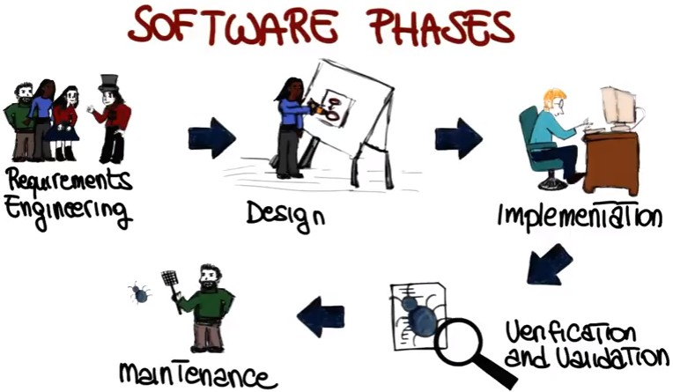
7/26/24
DA-IICT
IT 561: Adv Software Engineering
Software Process Models – RUP|XP|TDD
1
RUP – Rational Unified Process
Life Cycle model proposed by Booch, Jacobson, and Rumbaugh (“The three Amigos”) derived from the work on UML
Rational Unified Process (RUP) uses Unified Modeling Language (UML) as core notation
Described from 3 perspectives
¤ A dynamic perspective that shows phases over time;
¤ A static perspective that shows process activities;
¤ A practice perspective that suggests good practice.
Unified Process is distinguished by being
¤ Use-case driven
¤ Architecture-centric
¤ Iterative and incremental

Slide 2
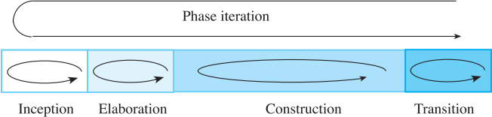


7/26/24
RUP – Rational Unified Process
RUP proposes a phase model that identifies four discrete phases in the software process
Inception
¤ Establish the business case for the system
¤ Decide to cancel or continue the project
Elaboration
¤ Develop an understanding of the problem domain and the system architecture.
Construction
¤ System design, programming and testing.
Transition
¤ Deploy the system in its operating environment.
Iterative Phase Model
Each phase may be enacted in an iterative way with the results developed as increments
The whole set of phases may also be enacted incrementally Whole set = cycle (later on..)
An iteration represents a set of activities for which there is a milestone (“well-defined intermediate event”)
The scope and results of the iteration are captured via discrete work products called artifacts.

Slide 3
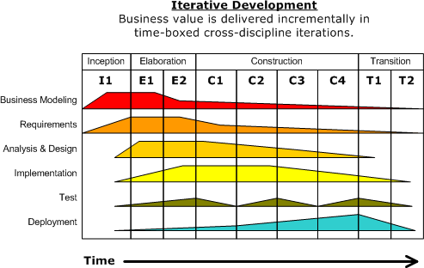
7/26/24
Artifact sets
Each artifact set has a different intention and uses different notations to capture the relevant artifacts.
Management Set:
¤Notation: Ad hoc text, graphics, textual use cases
¤Goal: Capture plans, processes, objectives, acceptance criteria.
Requirements set:
Notation: Structured text, models in UML (Use Case, Class, Sequence)
¤Goal: Capture the problem in the language of the problem domain
Design set:
¤Notation: Structured text, models in UML
¤Goal: Capture the engineering blueprints
Implementation set:
¤Notation: Programming language
¤Goal: Capture the building blocks of the solution domain in human- readable format.
Deployment set:
¤Form: Machine language
¤Goal: Capture the solution in machine-readable format.
RUP

Slide 4
7/26/24
Life of a Unified Process
Unified Process repeats over a series of cycles each concluding with a product release (increment) to the users
Cycles have no specific name but characterize the stage of maturity of the software system (like “birth” → “death”)
Each cycle has four phases (each with a number of iterations)
Inception, Elaboration, Construction & Transition
Phases have goals (→ result in artifacts or models)
Delivered products will be described by related models each with “trace” dependencies which chain backwards and forwards
¤ Use Case Model
¤ Analysis Model
¤ Design Model
¤ Deployment Model
¤ Implementation Model
¤ Test Model
Life of a Unified Process
Unified Process repeats over a series of cycles each concluding with a product release (increment) to the users
Cycles have no specific name but characterize the stage of maturity of the software system (like “birth” → “death”)
Each cycle has four phases (each with a number of iterations)
Inception, Elaboration, Construction & Transition
Phases have goals (→ result in artifacts or models)
Delivered products will be described by related models each with “trace” dependencies which chain backwards and forwards
¤ Use Case Model
¤ Analysis Model
¤ Design Model
¤ Deployment Model
¤ Implementation Model
¤ Test Model

Slide 5
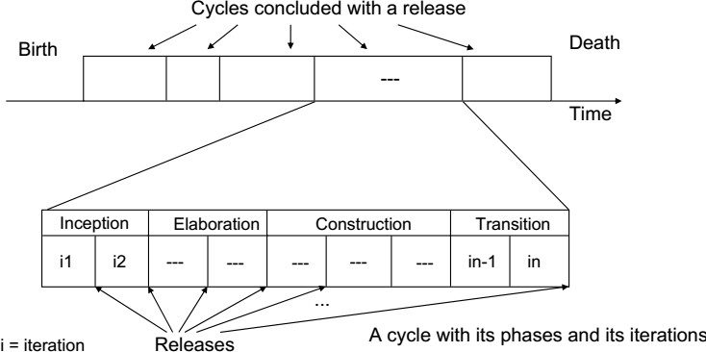
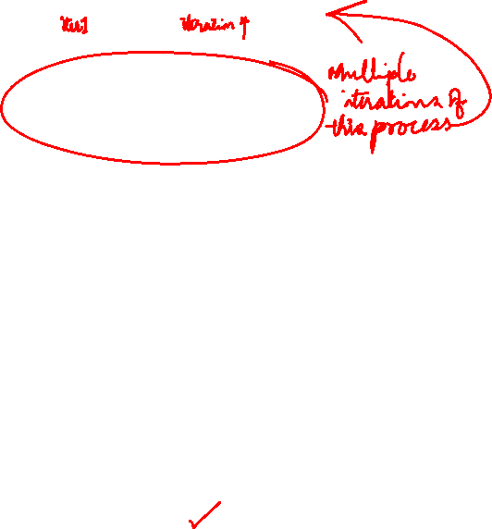
7/26/24
Life of a Unified Process
RUP - Summary
The RUP is not a suitable process for all types of development but it does represent a new generation of generic processes
Most important innovation:
¤Combination of many views
¤Deployment of software is part of the process (almost ignored in other process models)
Based on standards
¤ Object-oriented Modeling
¤ Unified Modeling Language

Slide 6
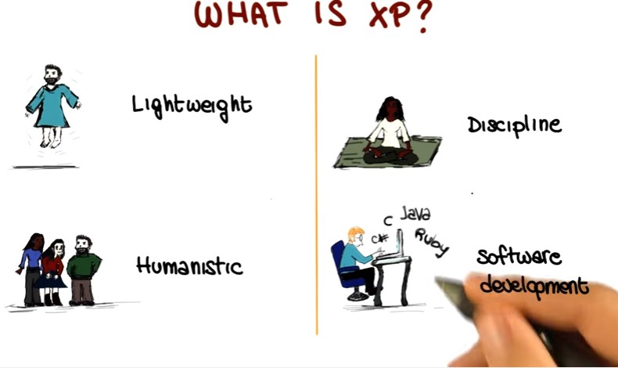

7/26/24
XP (Extreme Programming)
XP is a lightweight methodology for small to medium sized teams developing software in the face of vague or rapidly changing requirements.
Kent Beck
Agile

Slide 7
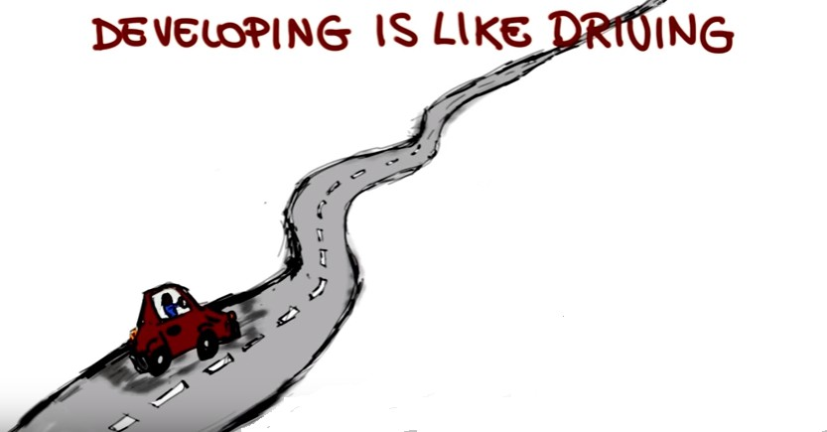
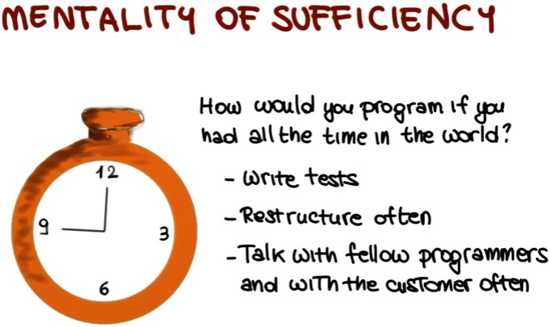
7/26/24

Slide 8
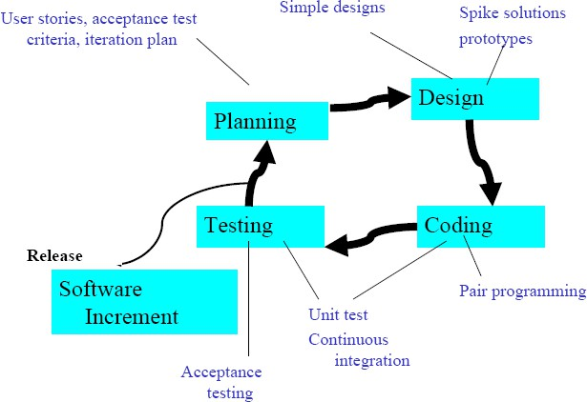
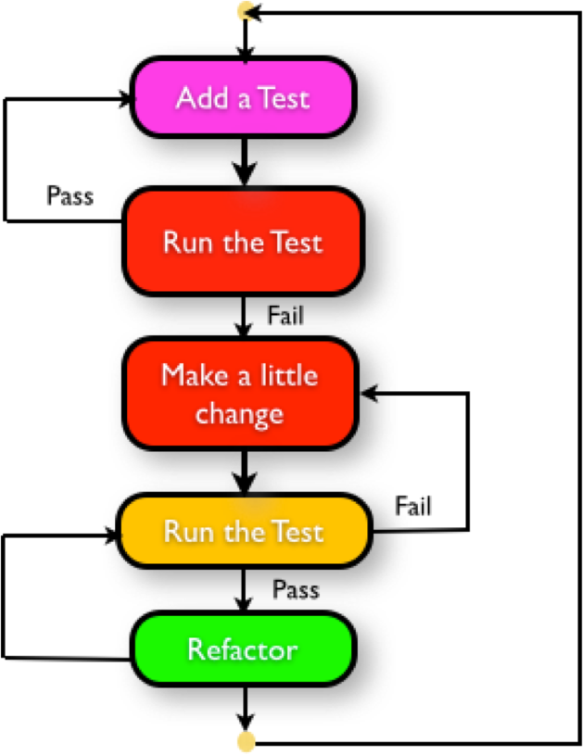
7/26/24
Extreme Programming consists of
Pair Programming Code Review Unit Testing
Integration Testing Planning Game Courage
Respect
TDD – Test Driven Development

Slide 9
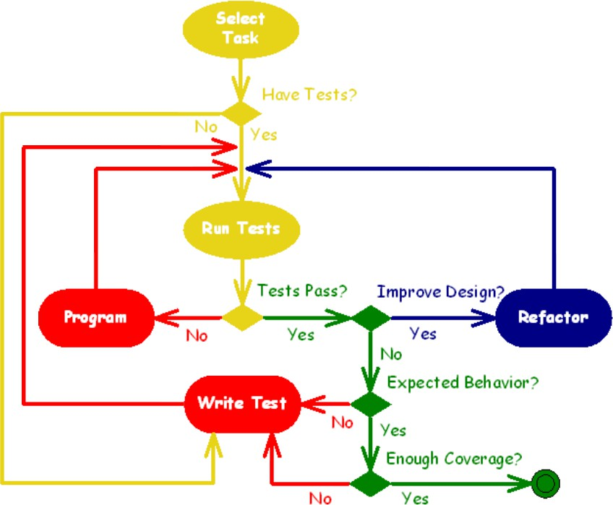
7/26/24
TDD – Test Driven Development
TDD – Test Driven Development
Test-driven development is not about testing.
Test-driven development is about development (and design), specifically improving the quality and design of code.
Cycle:
Write the test
Run the test (there is no implementation code, test does not pass)
Write just enough implementation code to make the test pass
Run all tests (tests pass)
Refactor
Repeat

Slide 10
7/26/24
TDD – Test Driven Development
Ensures quality
Keeps code clear, simple and testable
Provides documentation for different team members Repeatable tests
Enable rapid change
Questions???
Next Lectures…
Feasibility Studies…

